Slide 1
Week 2
Inflation Targeting Part 2

Slide 2
Week 1 summary
Key elements of an inflation targeting regime:
A measurable numerical target for inflation
A public commitment for achieving it
Short-term interest rate as the policy instrument
A supporting set of accountability and reporting arrangements
The above represents the emerging consensus on best-practice monetary policy framework over (approx) 1990 - 2010

Slide 3
Plan for today’s lecture
First hour:
Review of the legal basis for inflation targets in Australia and the US
Economic rationale for inflation targets
Practical aspects of system design
Decision-making under uncertainty
These points constitute a reasonably well settled understanding of how inflation targets work in normal times
Second hour: Begin discussion of unresolved issues post GFC
First issue: ZLB

Slide 4
The RBA Charter (legal basis of the inflation target)
Objectives of Monetary Policy
“The framework for the operation of monetary policy is set out in the Reserve Bank Act 1959 which requires the Board to conduct monetary policy in a way that, in the Board's opinion, will best contribute to the objectives of:
the stability of the currency of Australia;
the maintenance of full employment in Australia; and
the economic prosperity and welfare of the people of Australia.
The first two objectives lead to the third, and ultimate, objective of monetary policy and indeed economic policy as a whole. These objectives allow the Reserve Bank to focus on price (currency) stability while taking account of the implications of monetary policy for activity and, therefore, employment in the short term. Price stability is a crucial precondition for sustained growth in economic activity and employment.”
Source: Statement on the Conduct of Monetary Policy

Slide 5
Statement on the Conduct of Monetary Policy 1996
“In pursuing the goal of medium term price stability the Reserve Bank has adopted the objective of keeping underlying inflation between 2 and 3 per cent, on average, over the cycle. This formulation allows for the natural short run variation in underlying inflation over the cycle while preserving a clearly identifiable benchmark performance over time.”
Points to note:
numerical objective (2-3 per cent)
on average
underlying = abstracting from temporary or idiosyncratic factors
no new legislation, but an agreed interpretation of existing law

Slide 6
The 2023 RBA Framework Review
Background
framework reviews in other jurisdictions
reviews recommended by IMF and OECD
Issues
More stimulus needed post-GFC?
Criticism of RBA policy guidance
Best-practice governance structure?
Recommendations
Keep existing targeting framework
Separate monetary policy board
Various governance changes

Slide 7
Evolution of the Federal Reserve’s Monetary Policy Strategy (1) Refer Bernanke and Mishkin
US central bank legislation sets objectives of full employment and price stability
As in Australia, the shift from monetary targets to inflation targets was a gradual one
Federal Reserve began to announce targets for money supply growth in 1975 (the Friedman influence)
the ‘Volcker disinflation’ 1979−1982
framework for achieving it was a form of monetary targeting
FRB Chairman Greenspan announced in July 1993 that the Fed would no longer use any monetary aggregates as guide for conducting monetary policy

Slide 8
Evolution of the Federal Reserve’s Monetary Policy Strategy (2)
In the Greenspan era (ending in 2006), there was no explicit nominal anchor in the form of a publicly stated numerical U.S. inflation goal
General rhetoric was anti-inflationary
The intention was to prevent inflation from getting restarted
Under Bernanke, Fed evolved to an inflation target (2012)
As in Australia, the legal basis for this is found in interpreting the existing legislated mandate

Slide 9
The Federal Reserve’s Strategy since January 2012
The FOMC in January 2012 put out a statement of its longer-run goals and policy strategy in which it made its price-stability goal (which was already guiding policy for many years but had not been quantitatively explicit) more precise by specifying it as a longer-term 2 percent inflation rate.

Slide 10
The Federal Reserve’s Goals-and-Strategy Statement
Titled “Statement on Longer-Run Goals and Monetary Policy Strategy.” Reviewed each January since its initial release on January 24, 2012.
Excerpt: The inflation rate over the longer run is primarily determined by monetary policy, and hence the Committee (FOMC) has the ability to specify a longer-run goal for inflation. The Committee affirms its judgment that inflation at the rate of 2 percent, as measured by the annual change in the price index for personal con­sumption expenditures, is most consistent over the longer run with the Federal Reserve’s statutory mandate.

Slide 11
2020 framework review: ‘flexible average inflation targeting
Following periods when inflation has been running below 2 percent, appropriate monetary policy will likely aim to achieve inflation moderately above 2 percent for some time.
In seeking to achieve inflation that averages 2 percent over time, we are not tying ourselves to a particular mathematical formula that defines the average. Thus, our approach could be viewed as a flexible form of average inflation targeting.
Reasons:
avoid deflation risk + steer away from ZLB
these were the main priorities until around end-2021
Note the parallels with policy review in Australia

Slide 12
Economic rationale for inflation targeting
Instability of the monetary aggregates means that the interest rate must be the instrument of monetary policy
But the interest rate cannot itself be the objective (see Friedman)
The inflation target systematically links management of the instrument to the achievable long-run objective
A target helps to anchor expectations
It provides accountability

Slide 13
The time consistency problem
Arises from the fact that multi-period plans have to be implemented sequentially rather than in a single decision
The problem: It may be optimal to plan now to do something that will not be optimal when the time comes to do it. That is, the optimal plan may not be ‘time-consistent’
Example: It’s optimal to save regularly for retirement. But in any given period, utility is enhanced by spending a bit more than planned. So, you never get started.
Generic solution: a ‘pre-commitment mechanism’: eg regular salary deductions into the super fund

Slide 14
Application to monetary policy
Kydland & Prescott (1977) – the original statement of the problem
Unanticipated inflation adds to marginal utility when inflation is at its long run optimum
This means the long-run optimum cannot be a time-consistent equilibrium
The time consistent equilibrium generates higher than optimum inflation
Inflation has to be high enough that the marginal cost of more inflation is high enough to offset the marginal benefit

Slide 15
Kydland and Prescott on the time consistency problem
Source: Kydland and Prescott JPE (1977)
“Rules rather than discretion: the inconsistency of optimal plans”
The original paper on time consistency and inflationary bias.
This is a problem of multi-period decision making where decisions must be made sequentially

Slide 16
Definitions
Discretion: decisions are made independently in each period
Rules: policy is determined by a multiperiod rule governed by a precommitment mechanism
Consistent policy: choose the best action in each period taking the situation in that period as given, and assuming you will do the same in future periods.
Optimal policy: choose the multiperiod rule that delivers the best outcome over time
Problem
Time consistent policy takes expectations as given at each decision point.
It ignores the effect of the decision procedure on the available tradeoffs

Slide 17
Examples from Kydland/Prescott paper
Patent policy
At any point in time, it is optimal for the existing stock of inventions to be priced at marginal cost (eg medicines)
But, in a multiperiod context, the availability of patent protection encourages socially beneficial innovation
Macroeconomic policy
K&P argue that the same logic applied to the management of macroeconomic tradeoffs between inflation and unemployment.
This was a new and powerful argument at the time

Slide 18
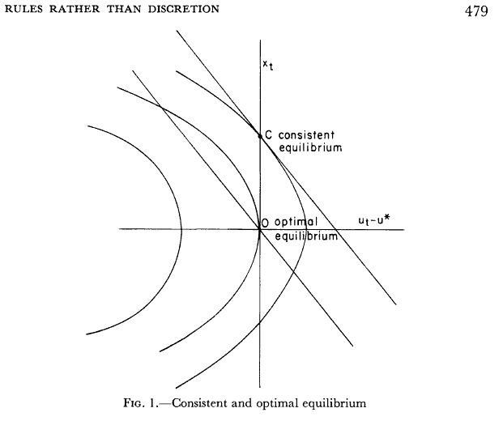


Kydland-Prescott model summary
Diagrammatic representation:
Phillips curve:
Rational expectations hypothesis:
Social objective function:

Slide 19
The ‘rules versus discretion’ debate
Friedman argued for rules-based policy on the grounds of limited information (‘long and variable lags’, avoiding policy mistakes)
Kydland-Prescott argument for rules applies even when there is perfect information on all sides.
Their argument doesn’t rely on short-sightedness (lack of information about, or concern for, the future)
instead, it stems from lack of capacity to constrain future decisions

Slide 20
Implications for institutional design
Inflation (1970s) was seen as the main problem
Time-consistency theory seemed to explain inflationary bias in MP
Due to instability of money demand, simple (quantity-based) rules could not be applied
Solution:
instrument independence for central bank
create incentive structure that supports optimum inflation outcomes
eg inflation target, ‘conservative’ central banker etc

Slide 21
Solving the time consistency problem
In monetary policy, the time consistency problem theoretically leads to inflationary bias
This can be solved (or mitigated) by a pre-commitment mechanism
This argument formed a big part of the debate on CB independence and targeting framework in the period 1990-2010
But, practical relevance in more recent times is debateable
other problems have gained more attention

Slide 22
Bernanke speech on monetary policy strategy
Bernanke’s speech, “Central Bank Independence, Transparency and Accountability,” speech, May 2010 (http://www.federalreserve.gov/newsevents/speech/bernanke20100525a.htm) summarizes many of the key considerations that underlie the formulation of monetary policy strategy.
The following quote refers specifically to the time-consistency problem:

Slide 23
Bernanke speech on monetary policy strategy: excerpt
“[A] central bank subject to short-term political influences would likely not be credible when it promised low inflation, as the public would recognize the risk that monetary policymakers could be pressured to pursue short-run expansionary policies… [T]he public will expect high inflation and, accordingly, demand more-rapid increases in nominal wages and in prices. Thus, lack of independence of the central bank can lead to higher inflation and inflation expectations in the longer run, with no offsetting benefits in terms of greater output or employment.”

Slide 24
Central Bank Independence
Central bank independence is seen as a solution to the time consistency problem
It provides a ‘pre-commitment mechanism’
Not a rule, but ‘constrained discretion’ (Bernanke/Mishkin)
Goal versus instrument independence:
Government sets the goal
Central Bank sets the instrument
Independence calls for a corresponding degree of accountability

Slide 25
Design aspects of independence and central bank governance
Who is the decision maker: Governor, Board or Monetary Policy Committee?
How are those people appointed?
What is the accountability mechanism: reporting requirement, letter of explanation; dismissal of Governor?
Hard- or soft-edged targets
What is the mandate (charter): see next slide

Slide 26
Should Price Stability Be the Primary Goal of Monetary Policy?
Hierarchical Versus Dual Mandates:
Hierarchical mandates give priority to price stability
Dual mandates put two or more objectives on the same legal footing: price stability and maximum (sustainable) employment (full employment, or output stability).
This is a legal distinction that may not be important in practice if policymakers have a Friedmanite view of what is achievable

Slide 27
Examples of Central Bank Charters
Australia: broad 3-part mandate
US: dual mandate (full employment and price stability)
Other Central Banks have ‘hierarchical’ mandates that put inflation control first
(eg Bank of Canada, Bank of England and ECB)
New Zealand has recently shifted from hierarchical to dual, partly for presentational reasons

Slide 28
The level of the target
The exact targets differ slightly from country to country
Why aim higher than zero?
cost/benefit considerations in inflation reduction
downward nominal rigidities
helps avoid the zero lower bound for interest rates
measurement bias in inflation

Slide 29
Summary: Key elements of flexible inflation targeting The 1990 – 2010 consensus
Goal setting by some combination of government and central bank
Instrument setting (R) by the independent central bank
Publicly stated numerical target for inflation
Accountability mechanism
Flexibility for decision-makers to respond to unforseen events
Arrangements for these things have tended to become more similar across countries over time since the early 1990s
Relation to financial stability objectives of CB still open to debate (topic for a future week)

Slide 30
The Taylor Rule A stylised summary of the decision process
We’ll see a reference to this in GPS paper next week
R = π + r* + ½ (inflation gap) + ½ (output gap)
Interpretation
Real policy interest rate is centred on its equilibrium value, and responds systematically to deviations of output and inflation from desired values
Definitions
Inflation gap: inflation minus the target rate.
Output gap (percentage difference between real output and its full-employment value).

Slide 31
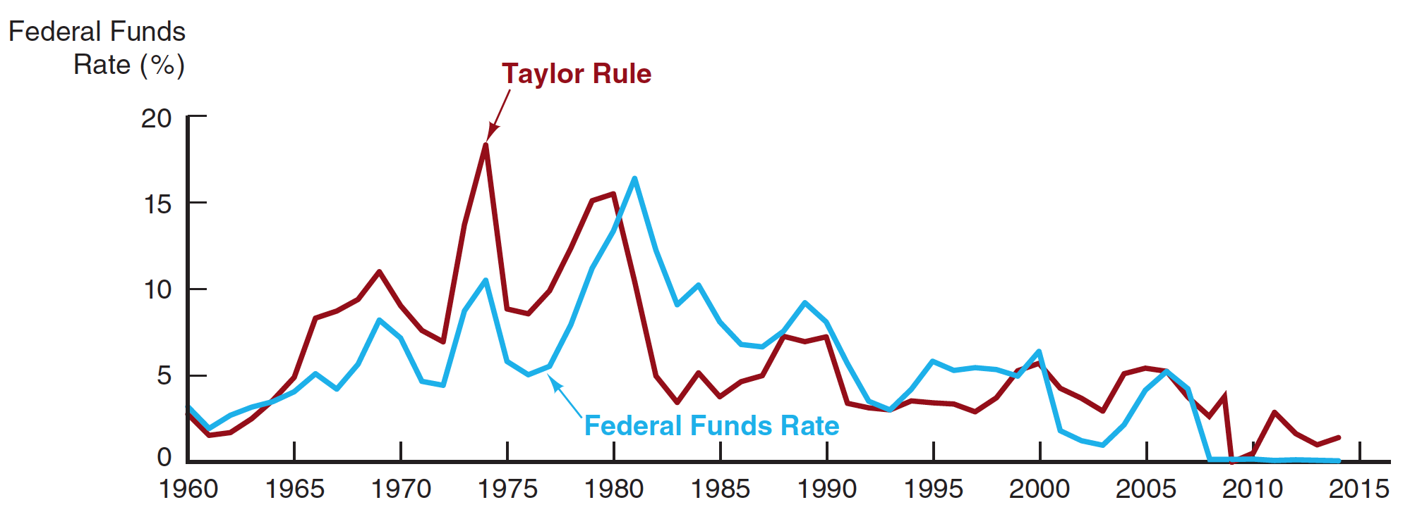
The Taylor Rule baseline for the Federal Funds Rate compared with the actual rate, 1970–2014
Source: Federal Reserve Bank of St. Louis, FRED database: http://research.stlouisfed.org/fred2/.

Slide 32
Some further points on the Taylor rule
It is an algebraic description of how central bank decision makers might summarise and respond to information
Not used anywhere as an actual procedural tool
Conceptually, it should be forward looking due to impact lags from monetary policy actions

Slide 33
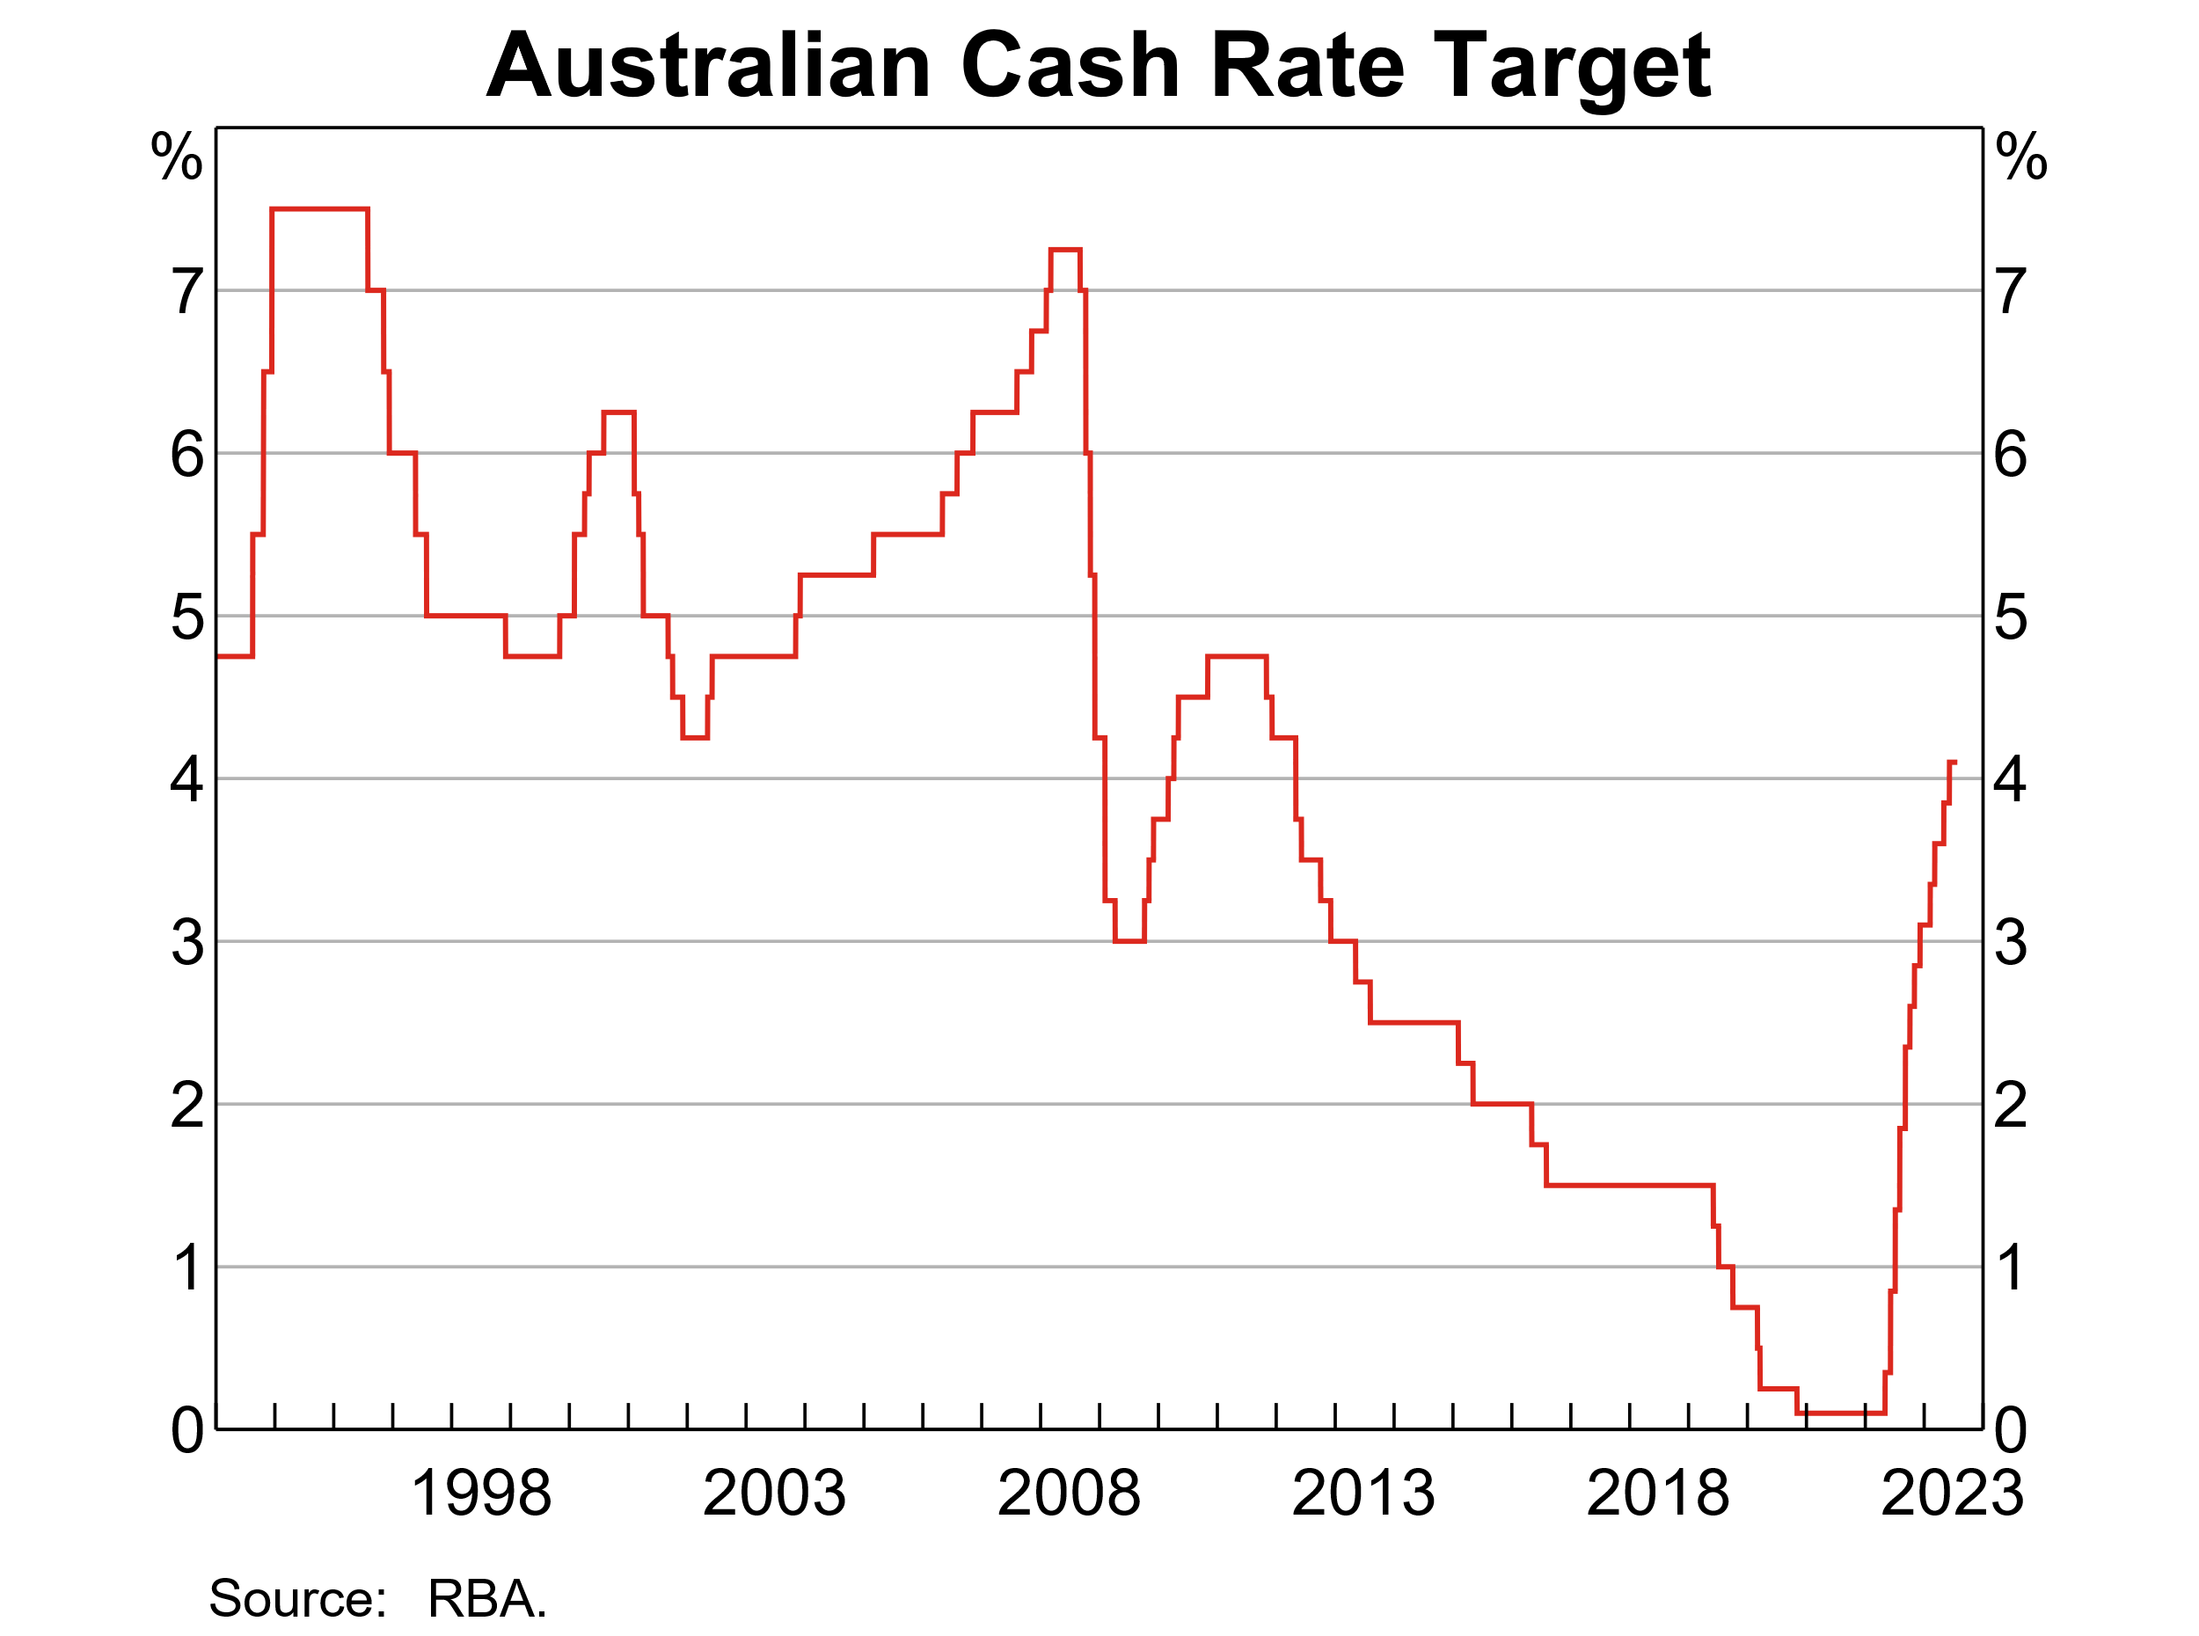
Monetary policy decision making under uncertainty
Puzzle: why are there so few sign reversals in interest rate policy decisions?
After most interest rate moves, the next move is usually in the same direction
This implies that, statistically, the policy maker could have expected a need to do more
So, why do less than you think will be needed?
Related question: why so many no-change decisions?

Slide 34
Possible explanations for relative lack of sign reversals
Cost of adjustment (political/reputational)
also helps explain frequent no-change decisions
Related point: aversion to reversals
can be interpreted as mistakes
Risk of instrument instability
Interaction between risk aversion and model uncertainty (Blinder)

Slide 35
Blinder’s summary principles
Step 1.Estimate how much you need to tighten or loosen monetary policy to "get it right." Then do less.
Step 2. Watch developments.
Step 3a. If things work out about as expected, increase your tightening or loosening toward where you thought it should be in the first place.
Step 3b. If the economy seems to be evolving differently from what you expected, adjust policy accordingly.

Slide 36
Sources of uncertainty facing central banks
Tracking error (forecasting vs ‘nowcasting’)
Recognition lags
Statistical and measurement error
Impact lags
Inherent unpredictability of the economy
Inherent unpredictability of policy impact

Slide 37
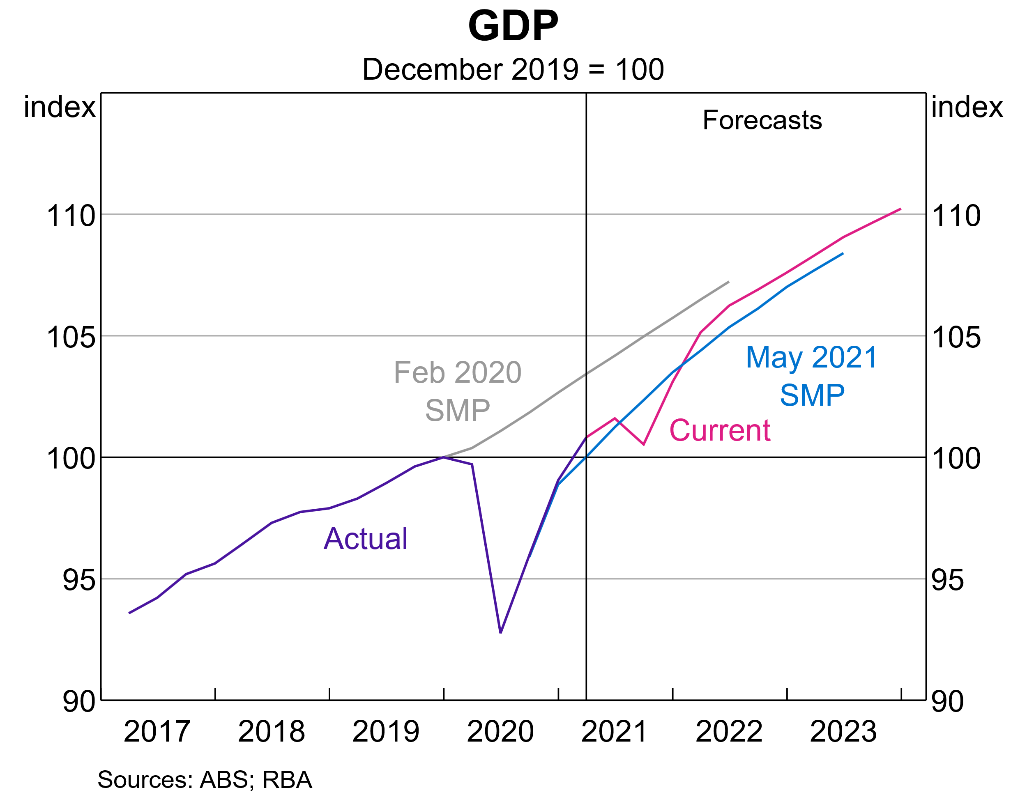
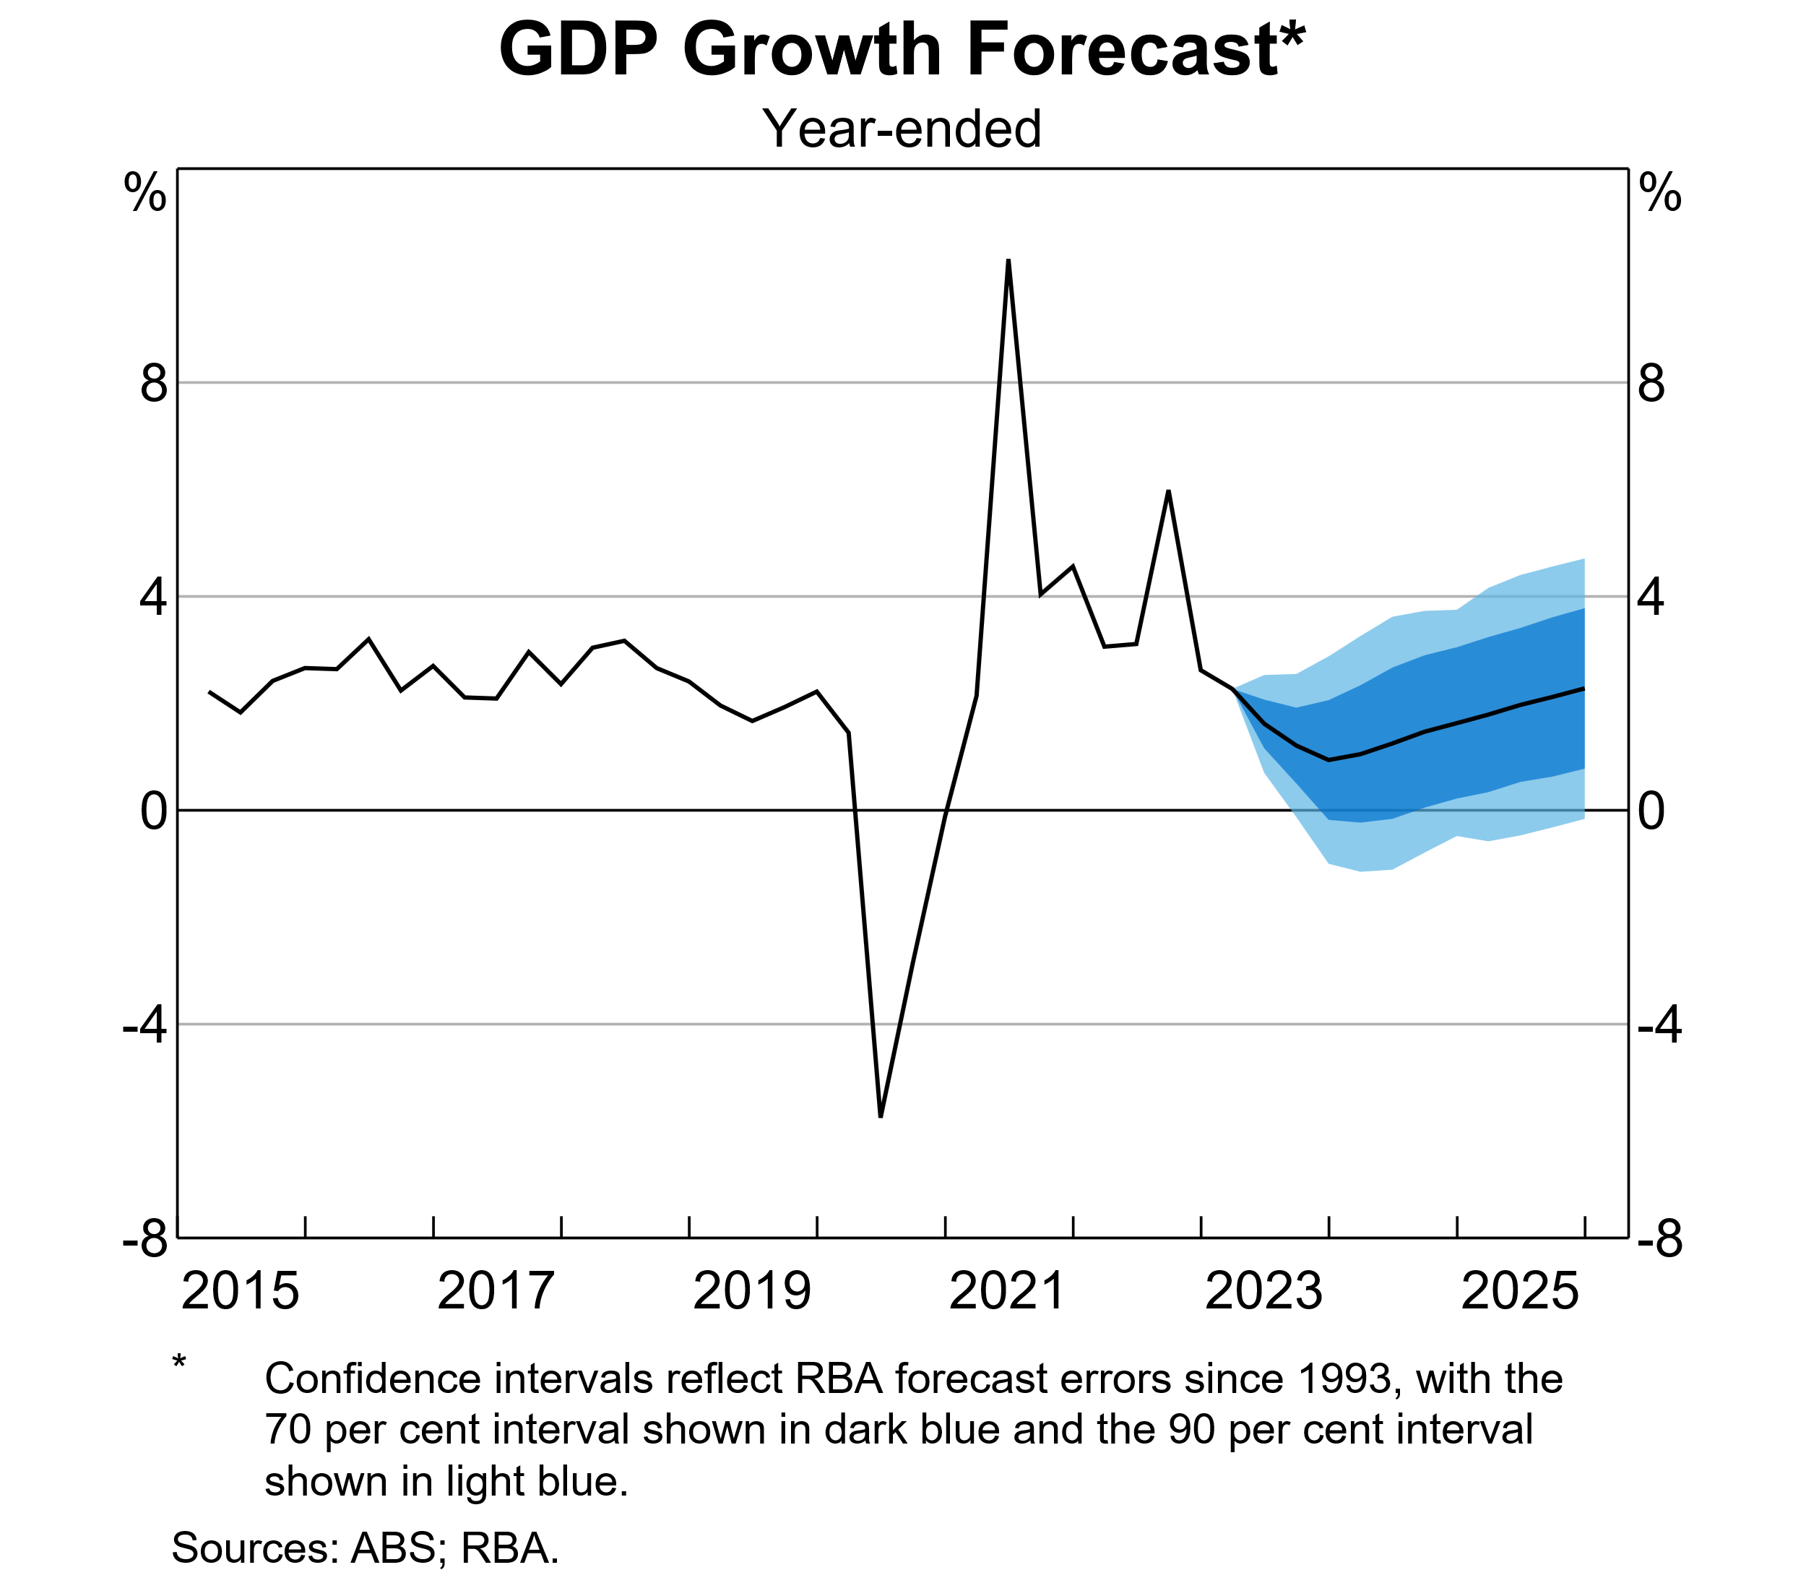
RBA forecasts and the range of uncertainty Source: Aug 2021 and 2023 SMP
Latest forecast, Aug 2023
Pre-Covid forecast and situation in May, Aug 2021, compared

Slide 38
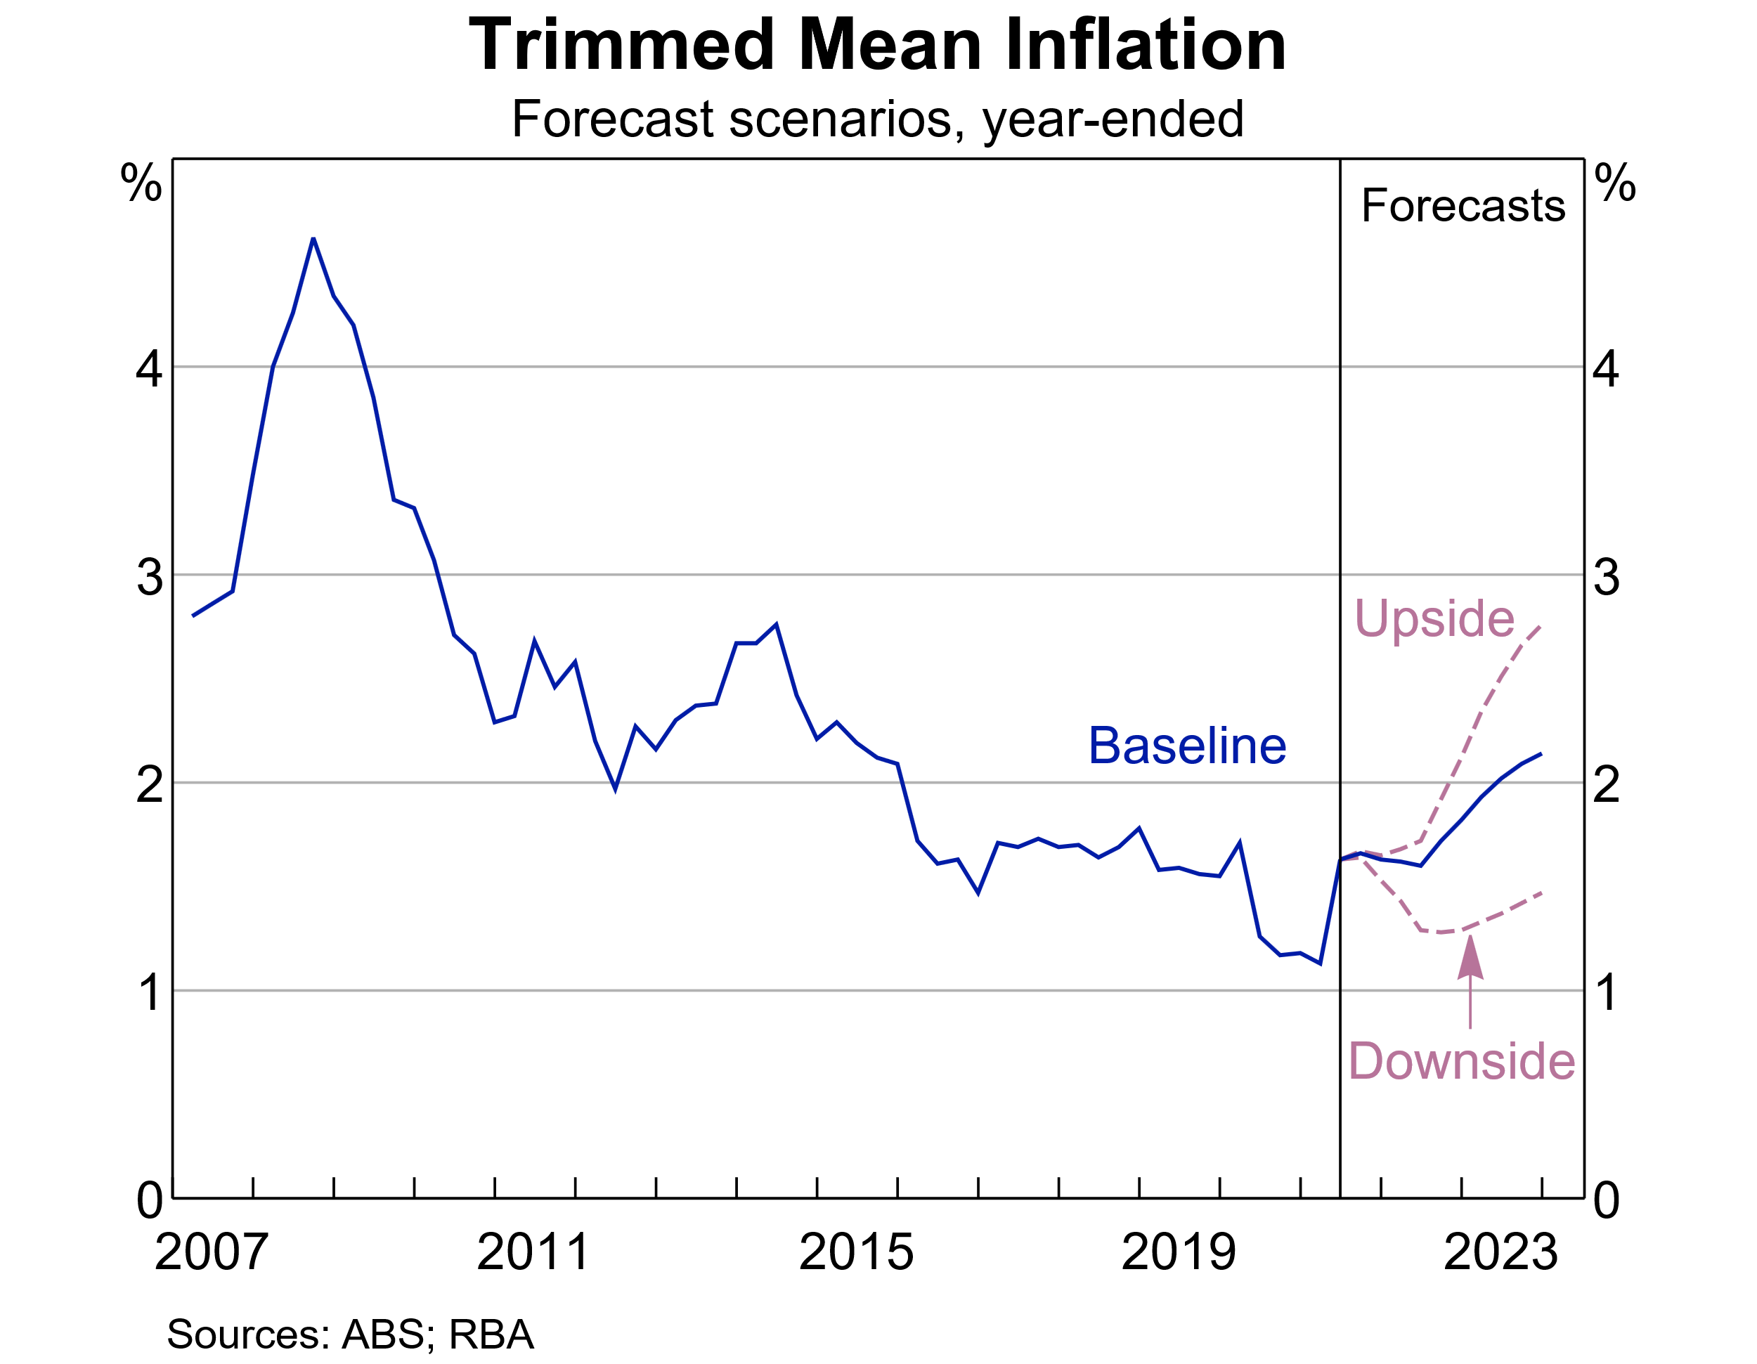
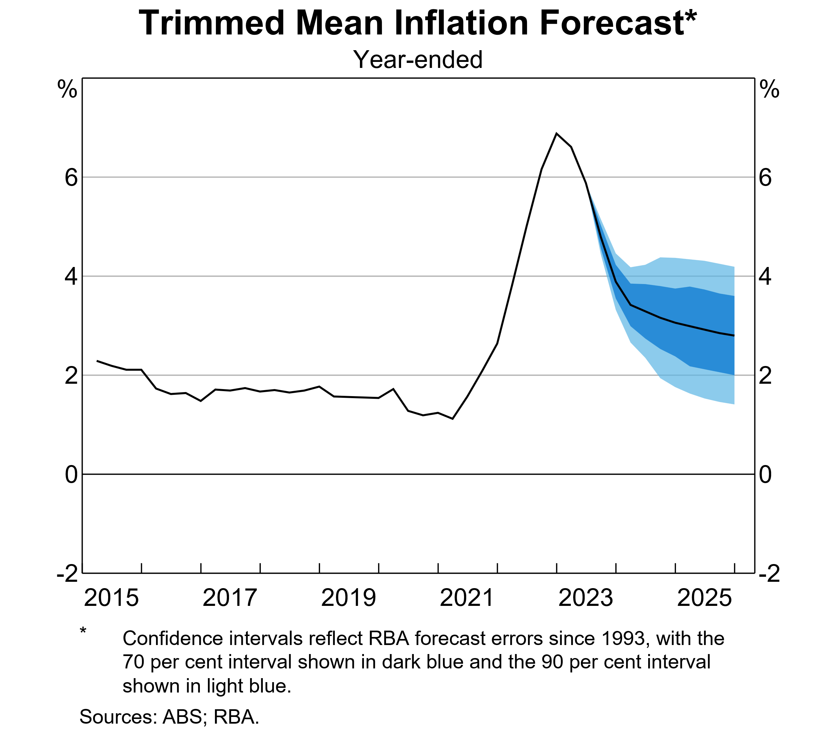
RBA forecasts and the range of uncertainty: inflation Source: Aug 2021 and Aug 2023 SMP
2021 forecast
2023 forecast

Slide 39
Decision-making in practice: a stylised decision procedure
Assume that the policy rate will evolve on a path consistent with current market expectations
Based on that assumption, and on other available information, forecast the key macroeconomic variables over the next 2-3 years
If inflation is forecast to be on a higher trajectory than desired, consider raising the cash rate
But, only do so if there is sufficient confidence in the assessment, and take into account risks
Repeat the process in a month’s time, taking into account any new information that becomes available in the meantime

Slide 40
Post-GFC: 3 unsettled issues
So far, we have covered the debate and emerging (1990 – 2010) consensus on how to do monetary policy in normal times.
However, the GFC and subsequent events highlighted three important unresolved issues:
the zero lower bound
monetary policy response to asset price bubbles
inter-relationship between monetary policy and financial stability policies of the central bank

Slide 41
Sources:
Bernanke (2002) Deflation: Making sure ‘it’ doesn’t happen here
Turner (2013) Money and Mephistopheles: How do we get out of this mess?
Rogoff (2017) Dealing with monetary paralysis at the zero bound, Journal of Econ Perspectives
Gruen, Plumb and Stone (2005) How should monetary policy respond to asset-price bubbles?
Edey (2013) The financial stability role of central banks

Slide 42
The zero lower bound (also known as Effective Lower Bound, or ELB)
Interest rates cannot go materially below zero
Why?
substitution into currency
public resistance to negative deposit rates
effect on bank profits
But, zero might not be low enough to counteract a severe recession
This means the economy could conceivably get caught in a debt/deflation spiral

Slide 43
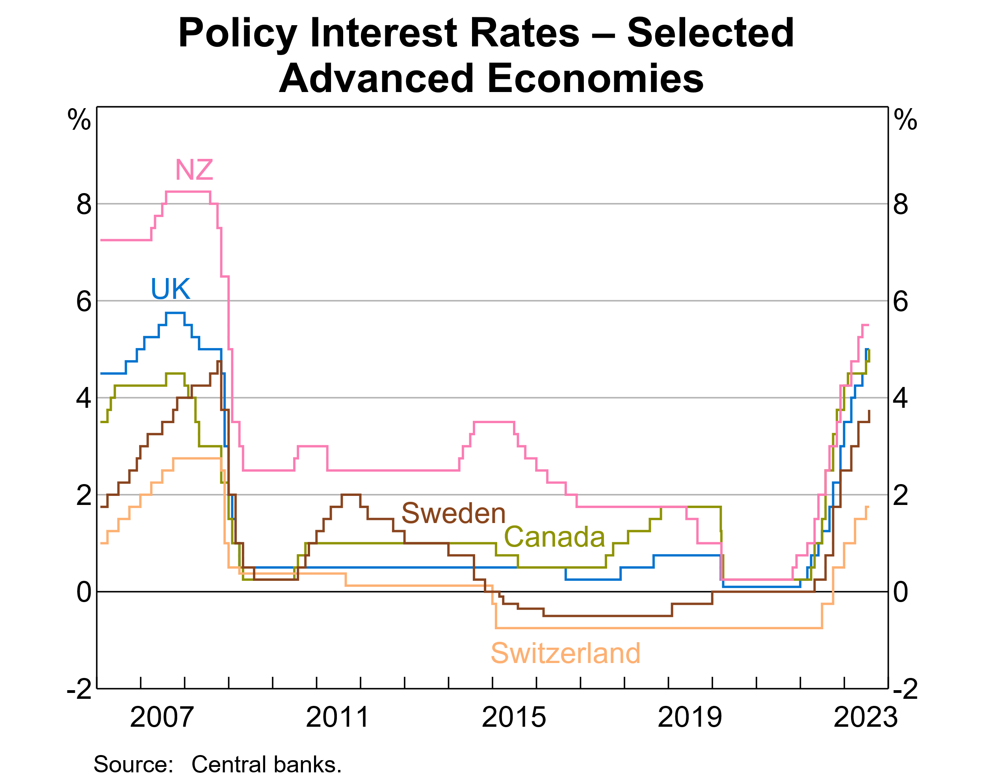
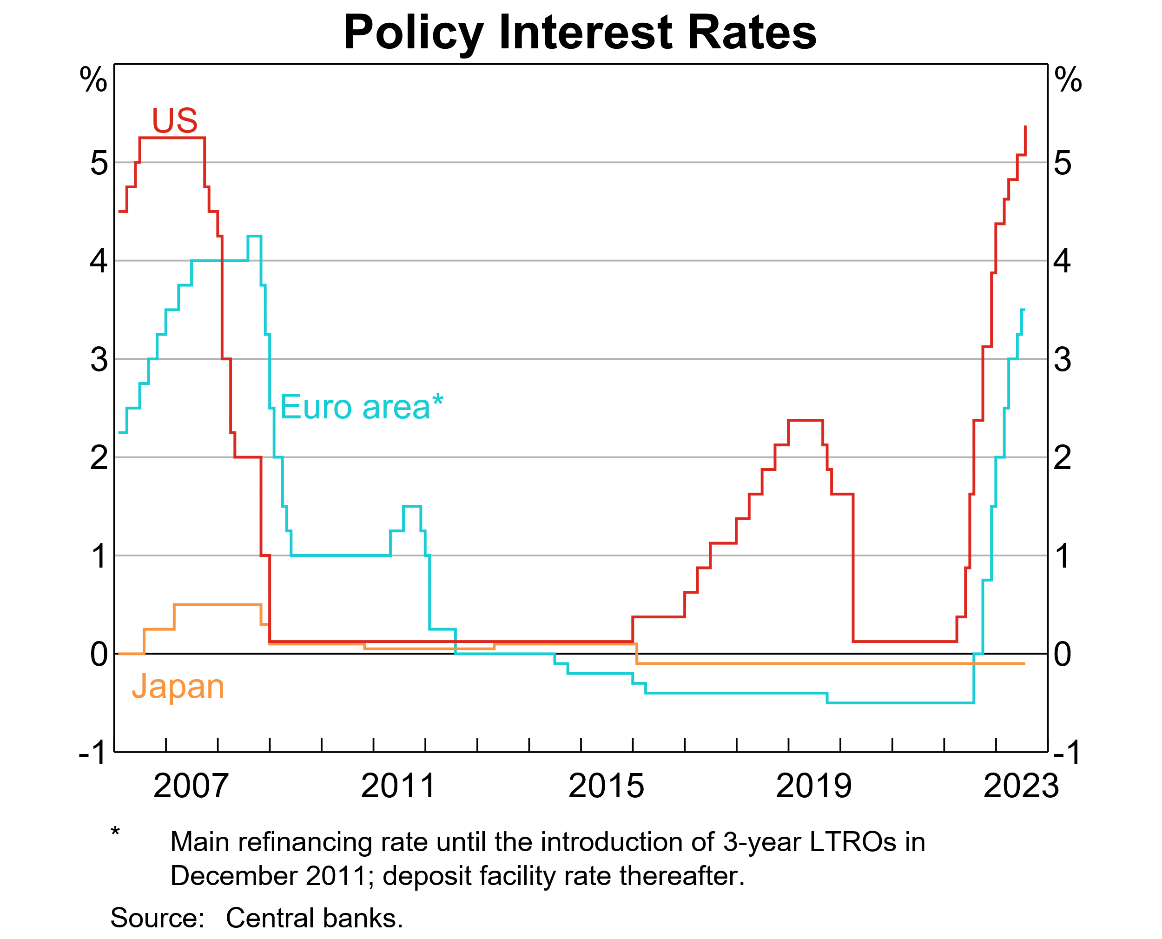

Slide 44
Relevance of the ZLB problem
The three largest advanced economies + UK all experienced ZLB following the GFC
Until recently (2022) this was a significant practical constraint on monetary policy
After initially avoiding ZLB, Australia also reached that position in late 2020
Japan hit ZLB in early 1990s and never escaped
US Fed began to think about ZLB in early 2000s (see Bernanke 2002)

Slide 45
Bernanke: Policy at the ZLB
Macroeconomic context in 2002:
low interest rates, low inflation
after-effects of tech stock crash
The change in mindset: previously, inflation was seen as the main threat. Now deflation was also a risk
Japan in 1990s seen as a precedent
Importance of avoiding deflation: the debt/deflation nexus
Bernanke’s position: it is always possible to stop deflation in a fiat money system

Slide 46
Deflation
Definition: A general ongoing decline in the prices of goods and services
Cause: a collapse in aggregate demand
Economic effects: recession, unemployment, financial stress
ZLB implies potential unstable rise in real interest rates
Adverse feedback to debt/financial distress
In that situation, has the CB “run out of ammunition”? (Bernanke: No)

Slide 47
Bernanke on fighting deflation
Prevention better than cure: aim for a buffer of inflation above zero
Use regulatory policy to promote financial stability (avoid financial stress and excessive debt)
Two plausible-sounding metaphors with opposing implications:
save your ammunition, or
fire the bullets while they still work?
Bernanke says the second one is correct

Slide 48
Curing deflation if prevention fails
Central proposition: fiat money can be created at essentially zero cost. Therefore its value can be debased by expanding supply sufficiently aggressively
this shifts us out from rate-setting (normal times) to quantity setting (emergency times)
The main problem in doing this once you reach ZLB is calibration, not effectiveness
Also there is the problem of overcoming legal/political safeguards against inflationary finance

Slide 49
Bernanke’s menu of policy options at ZLB
Purchase longer-term government securities to flatten the yield curve
Announce caps for longer-term interest rates
Use CB balance sheet to buy foreign government securities (equivalent to exchange rate intervention to depreciate the currency)
Money-financed tax cut/benefit payment (= Friedman’s “helicopter drop”)
Bernanke’s comment on Japan: obstacles to such policies are political rather than technical or economic

Slide 50
Subsequent debate after Bernanke
After GFC, the ZLB problem became generalised
Key elements of the Bernanke prescription became widely accepted, in a somewhat expanded form:
quantitative easing (QE) through CB asset purchases. Aim: to flatten the yield curve, expand liquid assets of the banking system, promote bank lending
credit easing. Targeted purchase of non-government credit instruments to improve market liquidity and narrow risk spreads in dysfunctional markets
enhanced signalling of CB intentions. Promote confidence that interest rates will remain low (note: relevance to Australia)
direct CB lending to banks, and incentives for banks to lend
interest rates below zero (slightly) in some jurisdictions

Slide 51
Two Bernanke recommendations not widely accepted
Exchange rate intervention/depreciation
international spillovers
“Helicopter money” – regarded as controversial in central banking circles, but was increasingly talked about during Covid-affected period

Slide 52
Covid impact on monetary policy debate
A central question at the time of the Covid outbreak (early 2020):
how to provide additional stimulus, if needed, in a renewed downturn, starting from ZLB?
Actual policy response: a combination of
fiscal stimulus
CB bond purchases
Since late 2021, the focus of CB debate and criticism has shifted rapidly towards need for inflation control

